Slide 1

Ben-Elsom.com
By Ben Elsom

Slide 2
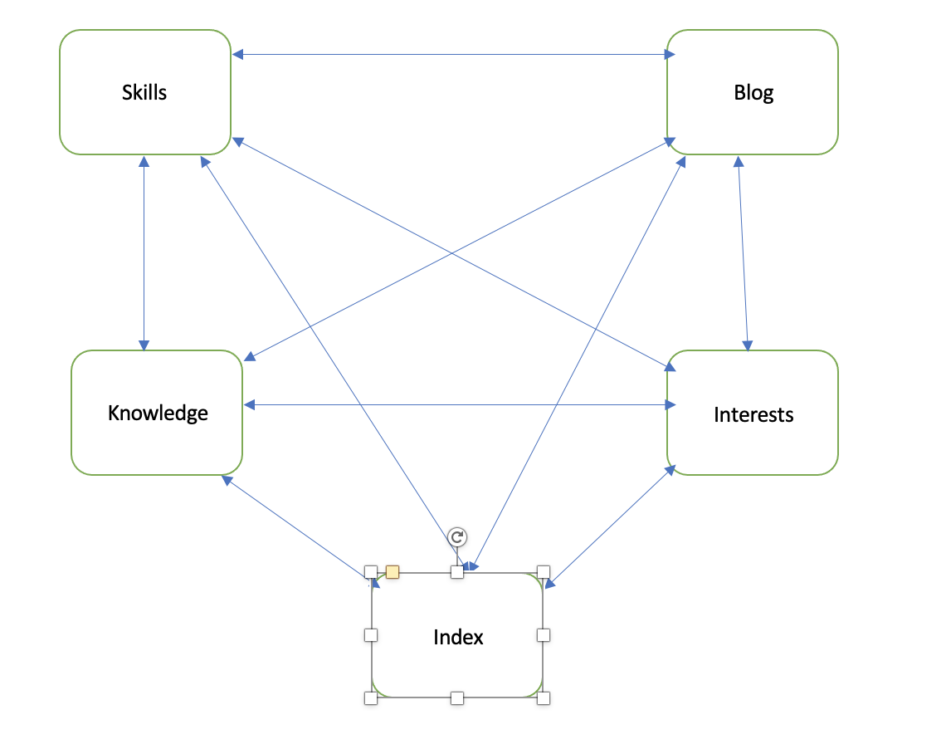
Sitemap

Slide 3
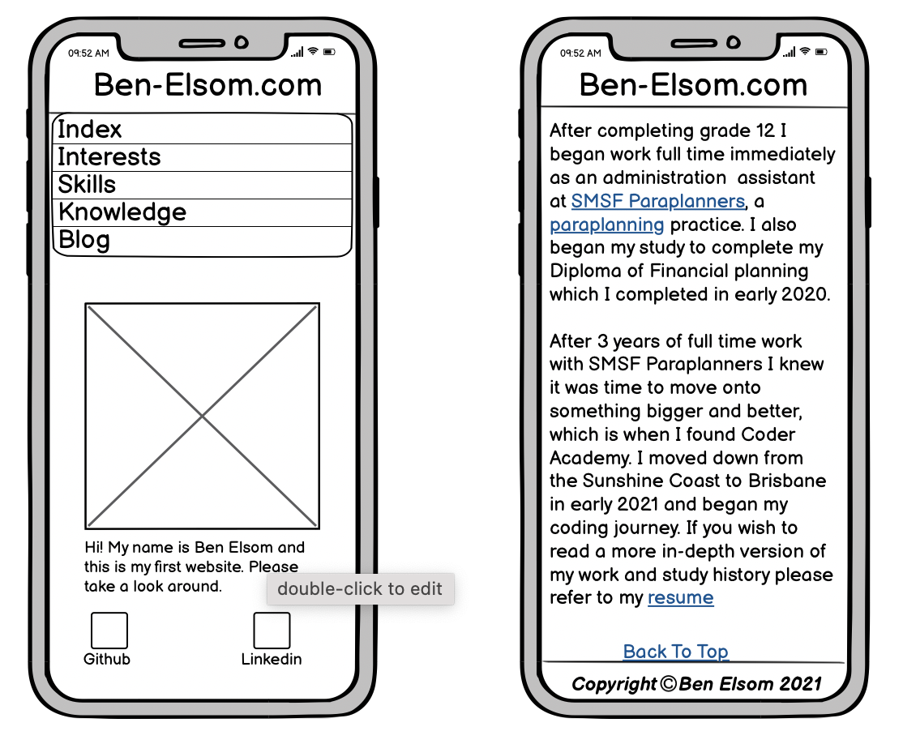
Wirefame – Index (Mobile)

Slide 4
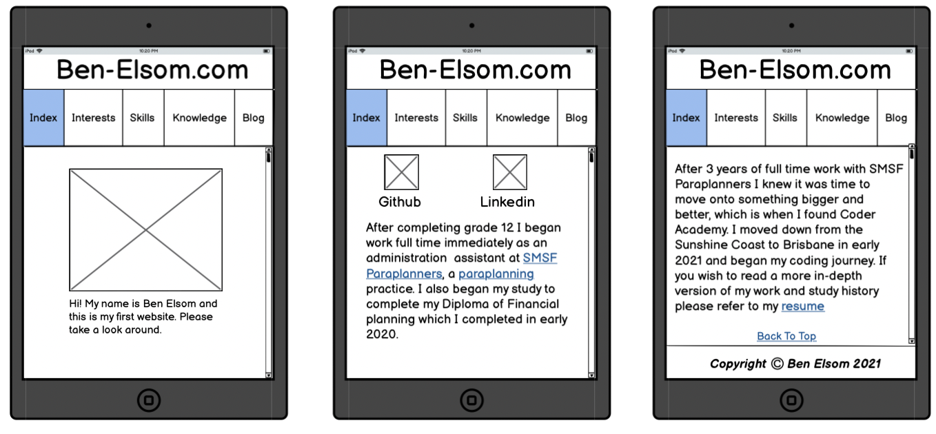
Wirefame – Index (Tablet)

Slide 5
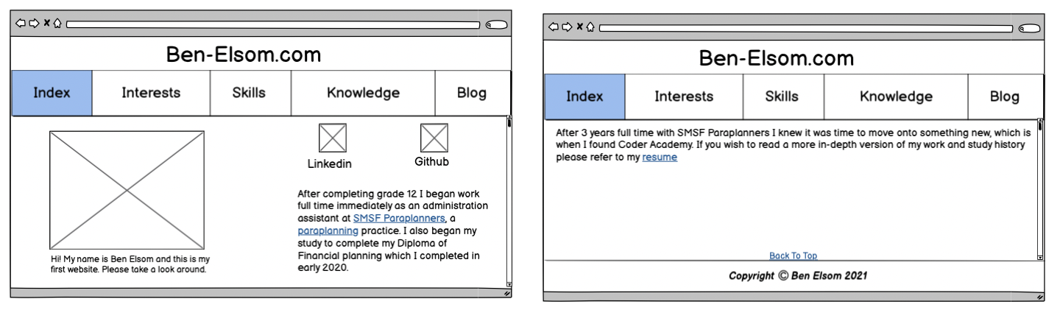
Wirefame – Index (Desktop)

Slide 6
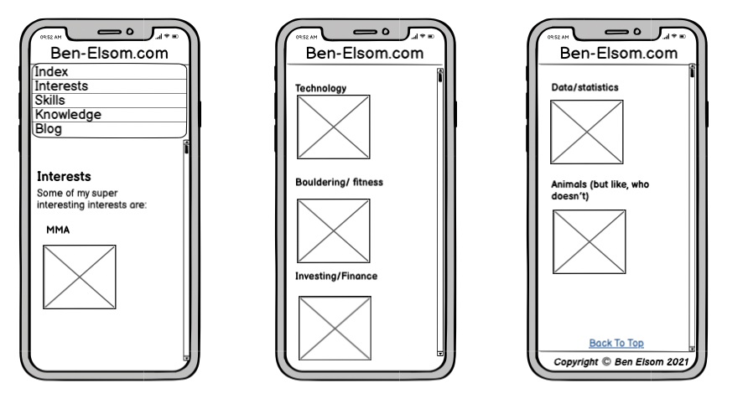
Wireframe – Interest (Mobile)

Slide 7
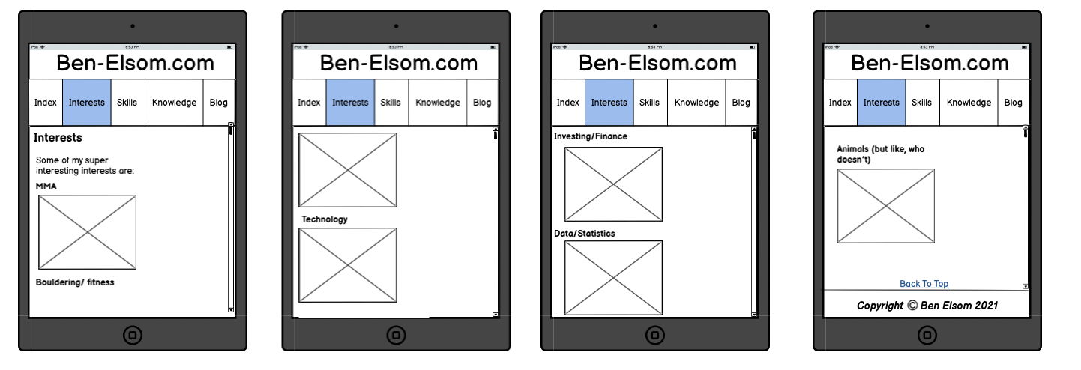
Wireframe – Interest (Tablet)

Slide 8
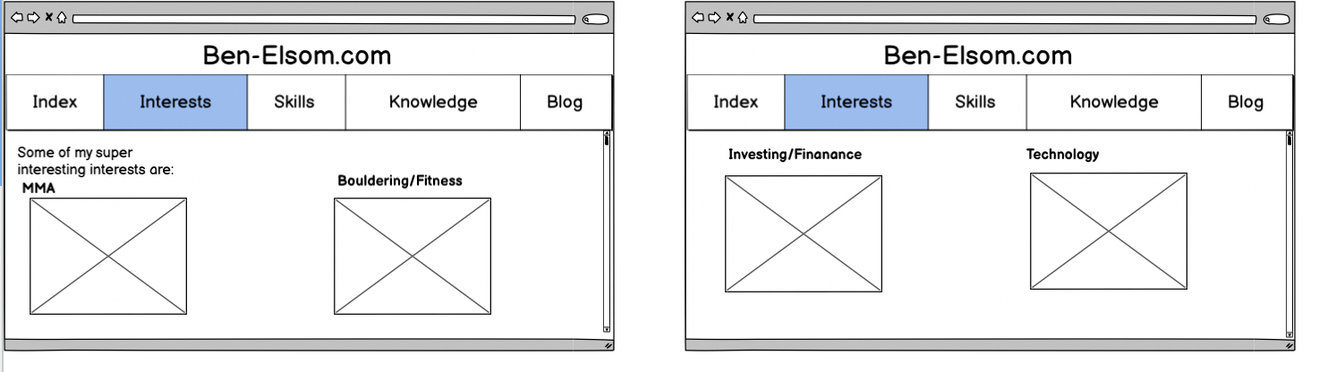
Wireframe – Interest (Desktop) P1

Slide 9
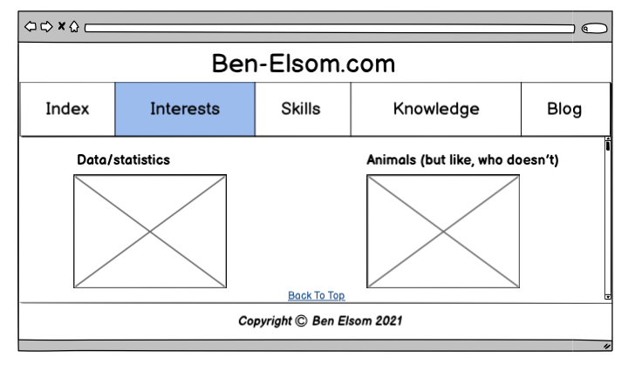
Wireframe – Interest (Desktop) P2

Slide 10
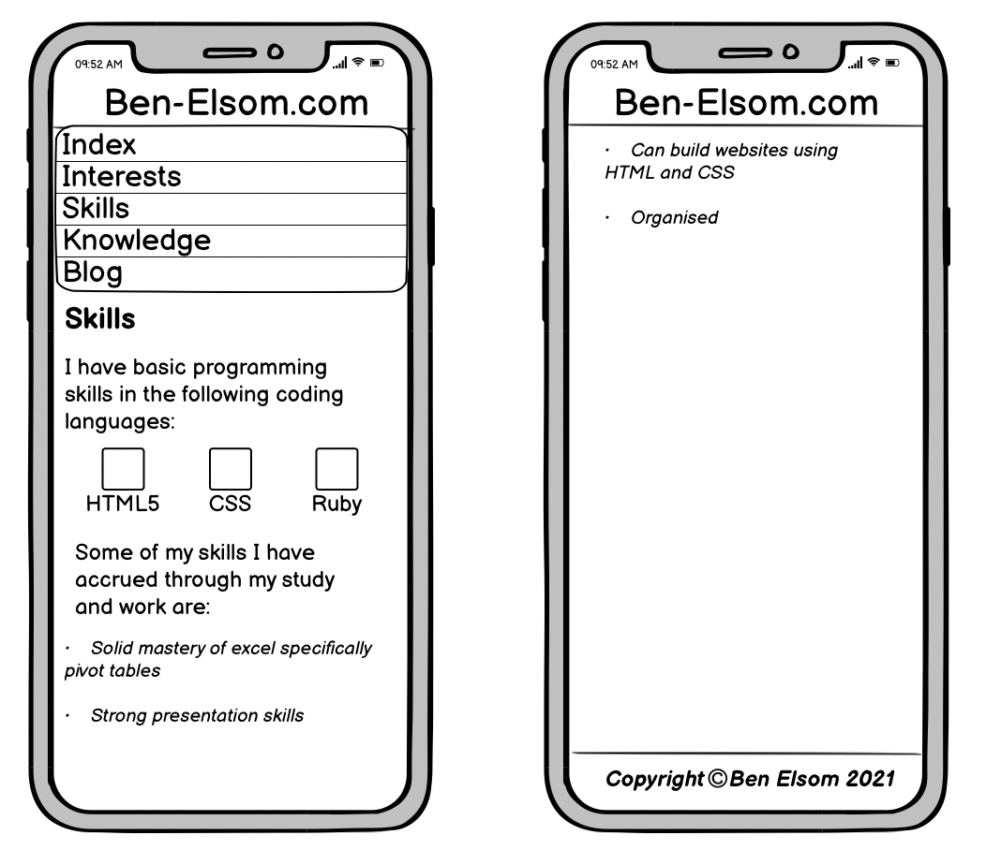
Wireframe – Skills (Mobile)

Slide 11
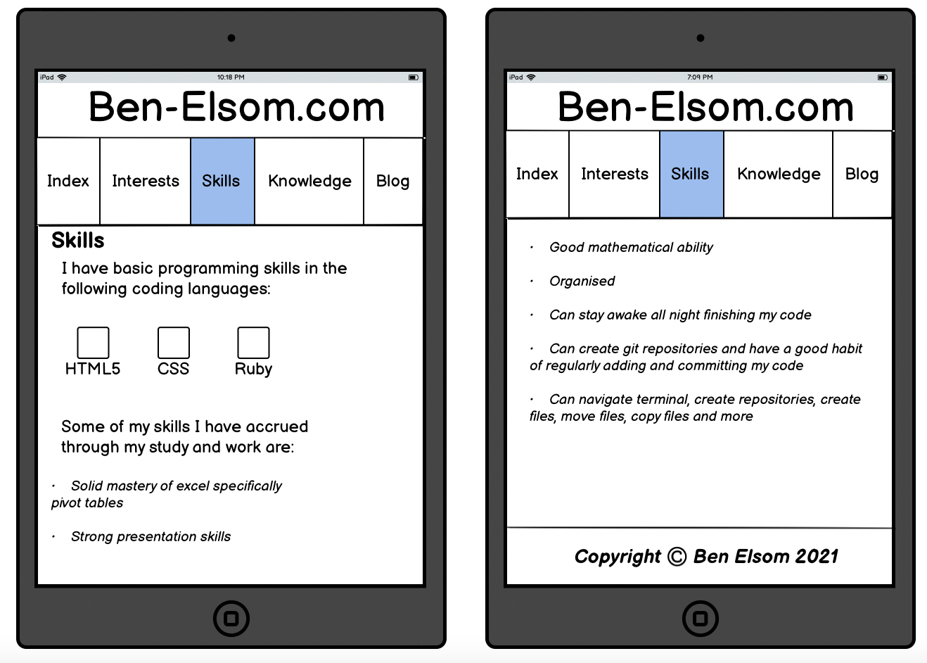
Wireframe – Skills (tablet)

Slide 12
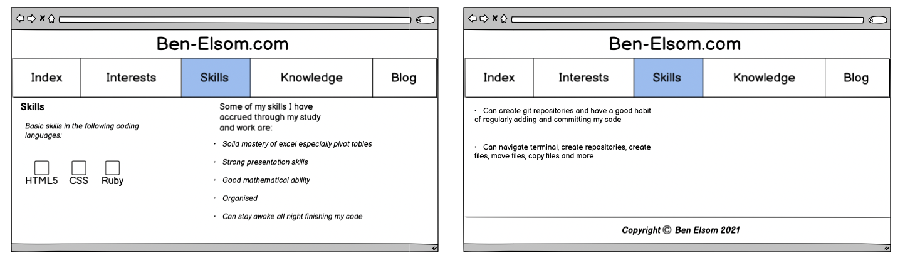
Wireframe – Skills (Desktop)

Slide 13
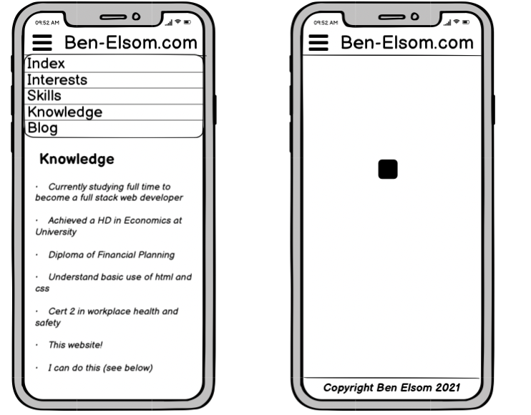
Wireframe – Interest (Mobile)

Slide 14
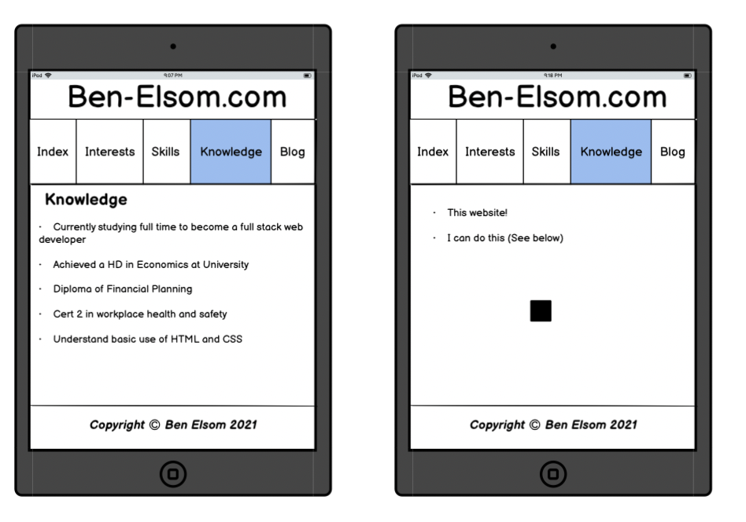
Wireframe – Interests (tablet)

Slide 15
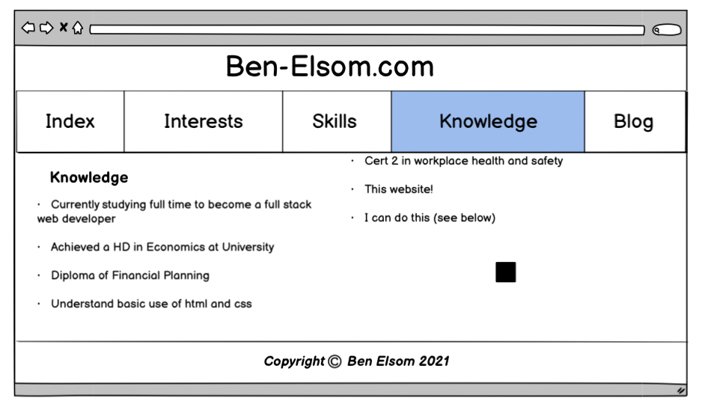
Wireframe – Interests (Desktop)

Slide 16
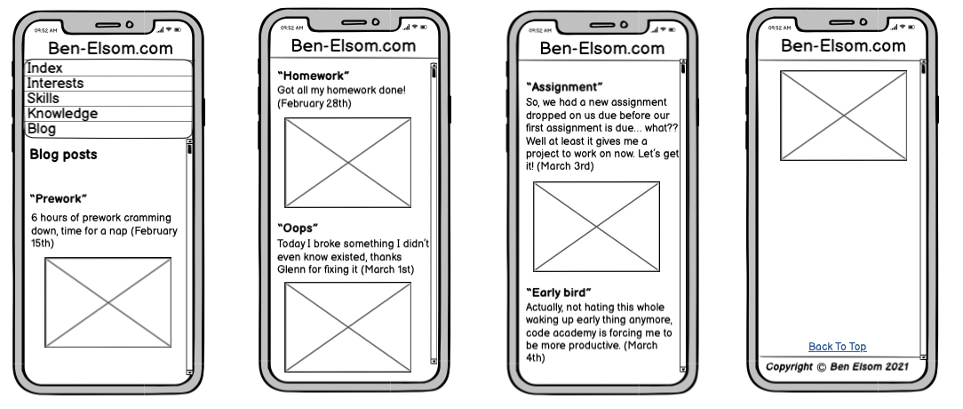
Wireframe – Blog (Mobile)

Slide 17
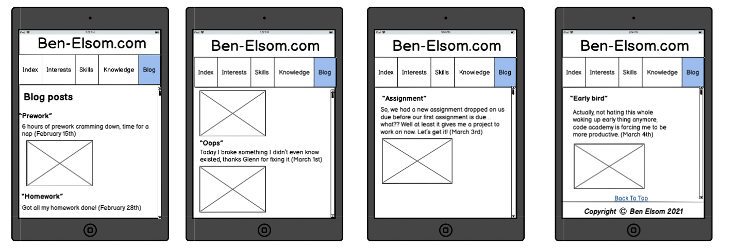
Wireframe – Blog (tablet)

Slide 18
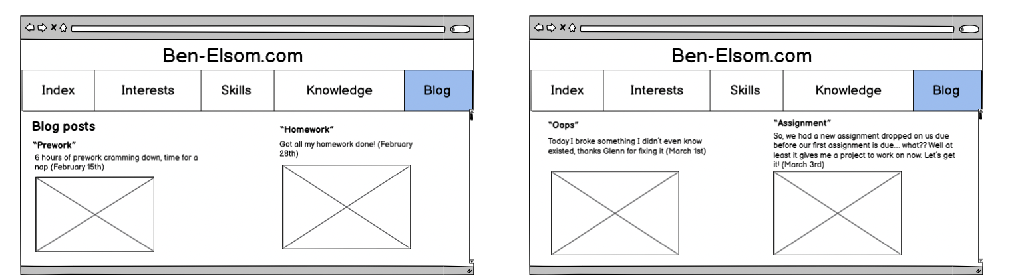
Wireframe – Blog (desktop) P1

Slide 19
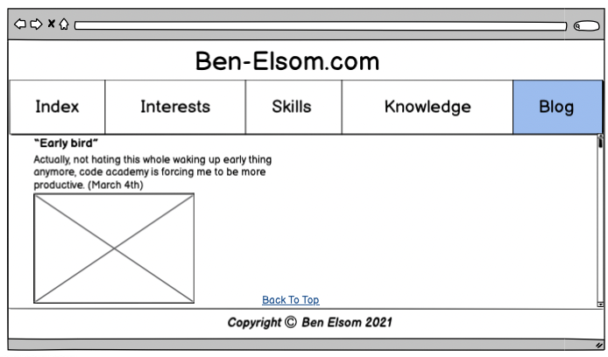
Wireframe – Blog (desktop) P2

Slide 20

Components

